Slide 1
House Prices: Advanced Regression Techniques
Guilherme Strachan, Ben Witte, Felipe Santos, Sanjay Pamnani

Slide 2
Our Results
Kaggle RMSE 0.1241
Ranking 1,152 (as of 6/3/18)
Final model was ensemble of GMB and Lasso
55% GBM
45% Lasso
Learning – MASSIVE!!
Price 12.4% off

Slide 3
Problem Statement and Challenges
Provided 79 explanatory variables that describe many aspects of residential sold homes in Ames, Iowa between 2006 and 2010
Tasked with predicting the sales price for each house
Classic regression problem however there are a large number of features/dimensions many of which are categorical variables
Additionally the data has missing values, outliers, as well as several features that do not conform to a Gaussian distribution

Slide 4
Our Approach
Technical Approach
EDA on the dataset to understand
Missingness
Distribution of numeric and categorical features
Frequency of features
Focused on preparing data for feature engineering and modeling
Market Approach
Also considered the residential real estate market dynamics and the overall economical cycle for the period under consideration
Included Case-Shiller housing index as well as some specific feature engineering to account for seasonality and cyclicality

Slide 5
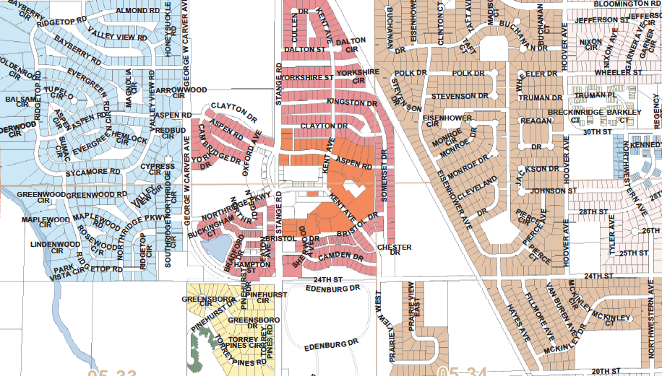
Missingness
Lot Frontage - Dependent on 2 features:
Lot Config (cul-de-sac, 2-3 sides fronted)
Lot Shape (regular, irregular)
Grouped by features, aggregated median for lot frontage

Slide 6

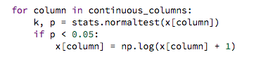
Feature Engineering
Normalization, by the grace of Gui
Looped normalized testing for all continuous numeric variables
If non-normal, log of variable

Slide 7
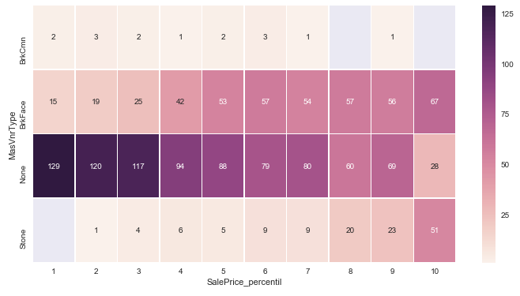
Feature Engineering
Heat Map Dummifying

Slide 8
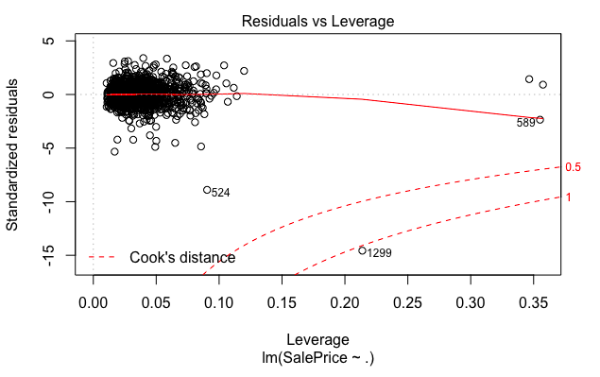
Outliers
MLR model with full data set w/o missing values, two observations

Slide 9
Gradient Boosting Model
Best prediction
R2 of 0.92
Cross-validation RMSE of 0.11
Feature selection
Full data set outperformed engineered data set
Model used 36 of 323 variables
Included Q4 seasonality penalty
Included Case-Shiller housing index
Fairly normal Q/Q plot
gbm = GradientBoostingRegressor(max_depth=2, n_estimators=500,
learning_rate=0.07, min_samples_split = 2)

Slide 10
Lasso Model
Second best prediction
R2 of 0.936
Cross-validation RMSE of 0.114
Feature selection
Full data set outperformed engineered data set
Model used 132 of 323 variables

Slide 11

Models We CUT!!
Random Forest
XGBoost
ElasticNet
Ridge
K-means
MLR
Forward/Backward Selection

Slide 12
Lessons
The Problem with Manual Feature Engineering & Selection
Could a Hybrid combination of manual and algorithmic be best fit?
Data Process Flow
Iterative approach – manual engineering, algorithmically influenced, repeat
Feature importance
The Power of Lasso! (and Gal Gadot)
K means and Categorical variables
Nope – use K Modes
“Next time will be easier.”
“I’ll be back”

